Slide 1
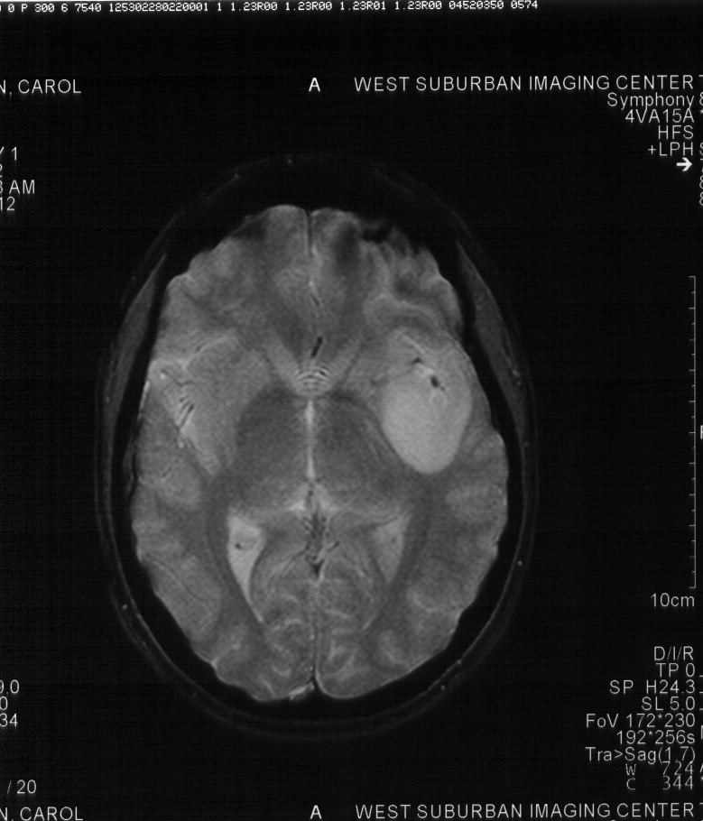
Optimizing Engagement of Latino Communities to Promote Equity in Low Grade Glioma Genomic Research (OPEL)
Elizabeth B. Claus, MD, PhD
Professor, Yale University
Attending Neurosurgeon, Brigham and Women’s Hospital
Bethany Kwan, PhD
Associate Professor
University of Colorado

Slide 2
Disclosure Information
Consultant for: Servier Pharmaceuticals, Pfizer

Slide 3
I. Study Overview: Goals & Objectives
Adapt and extend participant engagement for the PE-CGS U2C OPTIMUM project to optimize engagement with the Hispanic/Latino (H/L) community of people with low grade glioma in the International Low-Grade Glioma (LGG) Registry.
  Aim 1: Engage low grade glioma (LGG) Hispanic/Latino (H/L) community liaisons (HLCLs) in the design, conduct, and dissemination of LGG genomic research.
  Aim 2: Design and implement: Using participatory co-design methods including community engagement studios with the H/L LGG community, we will adapt existing LGG Registry recruitment, data collection, and return of results messages, materials, and protocols, consistent with the parent grant.
  Aim 3: Iteratively Evaluate and Adapt: We seek to elevate representativeness of H/L people with LGG in the Registry to reported national levels (SEER data).
  Target Population: Hispanic/Latino people with low grade glioma

Slide 4
II. Accomplishment Highlights
Recruitment efforts
Project Director at Yale (Mathew Krick, Y/YSPH’23) is bilingual-offers personal 1:1 support to enroll (n=21 so far!)
Consents, recruitment materials, questionnaire translated
Engaging Hispanic/Latino Working group via monthly meetings (RAC)
Assisted with the cultural and linguistic adaptation of participant engagement strategies e.g., recruitment, data collection, etc.
Created a content library for use in educational materials
Community oriented education and information
Hosted first Spanish-language webinar https://gliomaregistry.org/spanishwebinar1
Partnerships with Salud America (SA! at UT Health San Antonio) and the Yale Equity Research and Innovation Center (ERIC)
Partnership with ABTA to provide translation into Spanish for all webinars, website, and written materials
Plan Radio AMOR interview during Brain Tumor Month (May)

Slide 5
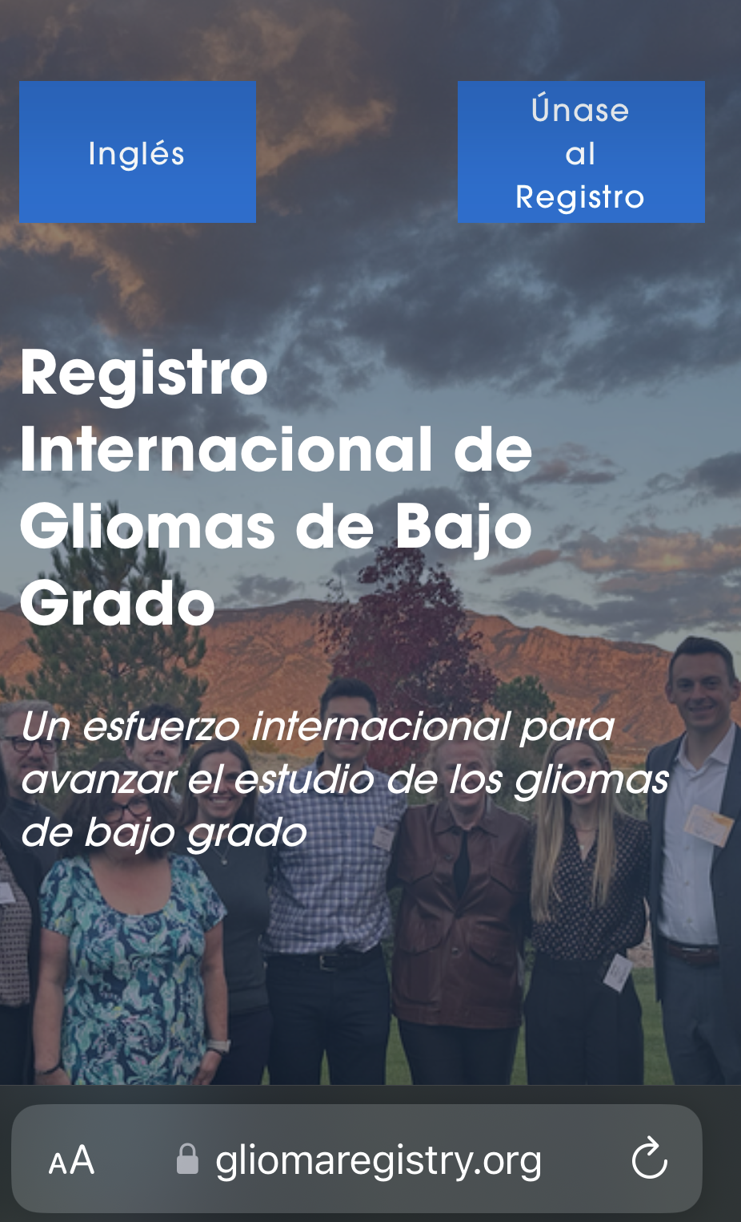
III. Recommendations
Engaging community members enables those with lived experience to share unique perspectives
Collaborating with and supporting development of community ambassadors is necessary for reaching intended audiences
Work with established, trusted sources within the H/L community to increase credibility and relevance of messages about research participation-alternative methods-social media versus radio, etc
Addressing logistical barriers to engaging people with limited English proficiency
Language equity in research materials, conducting meetings
“Give before you get”: importance of meeting the community’s needs (education and information) before requesting research participation

Slide 6
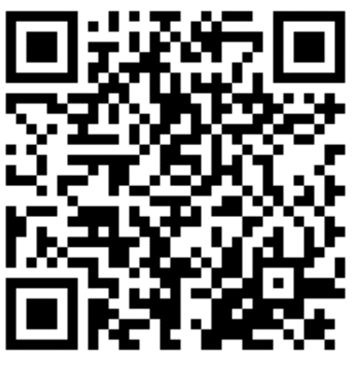
Thank you!
Elizabeth B. Claus, MD, PhD
elizabeth.claus@yale.edu
@gliomaregistry

